Slide 1


PART ONE: UNDERSTANDING CPD REQUIREMENTS
THE CPD FRAMEWORK

Slide 2
THE CPD FRAMEWORK

Slide 3
THE CPD FRAMEWORK – WHAT IS IT?
The CPD Framework was designed by the National Teaching Council to serve as a guide for teachers and service providers to plan, design and implement appropriate Professional Development (PD) plans and programs.
It is a document that highlights professional development activities, processes, procedures and products that define teacher career growth.

Slide 4
WHAT IS PROFESSIONAL DEVELOPMENT (PD)
PROFESSIONAL DEVELOPMENT (PD) refers to the process by which teachers maintain and enhance their knowledge, skills and experiences gained as they work, beyond any initial training. Furthermore, it is a record of what teachers experience, learn and apply.
It includes training and education programs organized within or outside the school environment which NTC approves as being relevant to the teaching profession and meeting prescribed standards.

Slide 5
RATIONALE FOR INTRODUCING PD ACTIVITIES
To provide guidance for teachers to continue to improve their competencies to maintain the integrity of the teaching profession and improve their professional status.
It is envisaged that going through the listed accredited PD activities would help maintain and enhance the knowledge, skills, attitudes and experiences gained after the initial training of teachers.
It is essential for teachers as professionals to preserve their professional integrity by updating their knowledge and skills to keep them abreast of contemporary issues and approaches in education.

Slide 6
Why Continuous Professional Development (CPD)
Knowledge is constantly evolving, new discoveries are made everyday that challenge our convictions, what we know, and how we do things
Atomic theory
Solar systems
Rotation and revolution
Geocentricism and heliocentricism
ICT migration
Issues of gender & sex

Slide 7

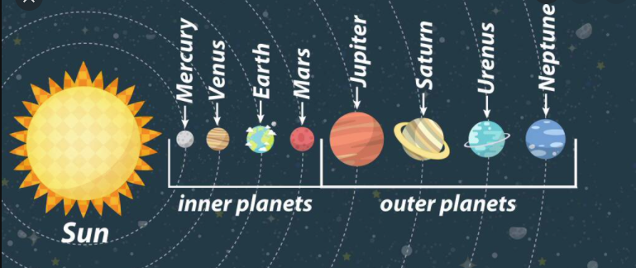
Example of why we need CPD
Planets in the solar system
Nine (9) recognized planets before 2006,
includes Pluto
Eight (8) recognized planets after 2006, excludes Pluto

Slide 8
THE IN-SERVICE TEACHER AND THE NTC
WHO IS AN IN-SERVICE TEACHER
A PERSON EMPLOYED BY VIRTUE OF BEING TRAINED AS A TEACHER AND RECEIVES SALARY IN THAT RESPECT.
TWO GROUPS OF IN-SERVICE TEACHERS ARE THOSE IN THE CLASSROOM AND THOSE IN ADMINISTRATION/MANAGEMENT POSITION
TEACHERS IN THE CLASSROOM
THESE ARE INDIVIDUALS WHO HAVE GONE THROUH TEACHER EDUCATION PROGRAMME IN A RECOGNIZED TEACHER EDUCATION INSTITUTION AND HAVE RECEIVED A MINIMUM OF THREE YEAR TRAINING ON TEACHING SUBJECT (S) AND METHODOLOGY, AND ARE CURRENTLY FACILITATING LESSONS IN CLASSROOMS
TEACHERS IN ADMINISTRATION OR MANAGEMENT
THESE ARE INDIVIDUALS WHO WERE TRAINED AS TEACHERS IN RECOGNIZED TEACHER EDUCATION INSTITUTION BUT ARE CURRENTLY WORKING AS EDUCATIONAL ADMINISTRATORS, MANAGERS. EG. HEADS OF INSTITUTIONS, CS, STAFF AT GES DISTRICT, REGIONAL , HEADQUARTERS OR AT ANY AGENCY UNDER THE MINISTRY OF EDUCATION

Slide 9
WHAT IS EXPECTED OF THE IN-SERVICE TEACHER?
Work within the confines of the NTS, Code of Ethics and Professional
Practice and all the guidelines designed for teachers by the Council
BUILD PORTFOLIO
Primary and JHS Teachers are expected to attend both supply (minimum of 27) and demand-driven CPD activities.
In addition, teachers should also embark on self-initiative activities such as writing of a book chapter, conducting action research, attending conference marking etc. The details are in the CPD framework on the NTC website.
ATTEND CPD PROGRAMS
Teachers are to show evidence of how they demonstrate professionalism in their practice
This evidence can be in hard copies such as pictures and write-ups or electronic versions such as videos or attached files.
RENEW LICENSE
All in-service teachers shall be issued with a professional license without sitting for an examination
This license will be renewed every three years on condition that the teacher has: 1. lived within the confines of the code of ethics and professional standards 2. met the required CPD points at the current rank within the 3year TCPD cycle 3. passed the portfolio assessment
In addition, the Teacher Training Log book can also serve as evidence. Details of portfolio content is found on pages 34-35 of NTS and in the portfolio guidelines uploaded on NTC website

Slide 10
ACTIVITIES THAT CONSTITUTE PD
Self-directed training using tools like the EmoEles self-directed learning tool/system (self-studying a course text from journals, books etc, self-studying professional videos, professional audios, etc).
Engaging in group activities either with professionals or learners (eg. Meetings, research, writing of a book, attending conferences or seminars, taking learners for excursion, presenting at workshops etc).
Receiving training or education from experts (eg. SBI/CBI /DBI).
Performing duty related activities (lesson or learning notes preparation, scheme of learning/scheme of work preparation of action plan, writing of reports, conducting of assessment etc.).

Slide 11
THUS, TYPICAL MODES OF PROFESSIONAL DEVELOPMENT ARE
Individual reading/study/research.
Study groups among peers focused on a shared need or topic.
Observation: teachers observing other teachers.
Coaching: an expert teacher coaching one or more colleagues.
Mentoring of new educators by more experienced colleagues.
Team meetings to plan lessons, problem solve, improve performance

Slide 12
MEANS OF ATTAINING CPD
INSET
(Activities that support professional enhancement of competences while in the service: study leave, on the job training and education)
PORTFOLIO DEVELOPMENT
Gathering evidence on the use of the competences acquired to improve learners’ attainment).

Slide 13
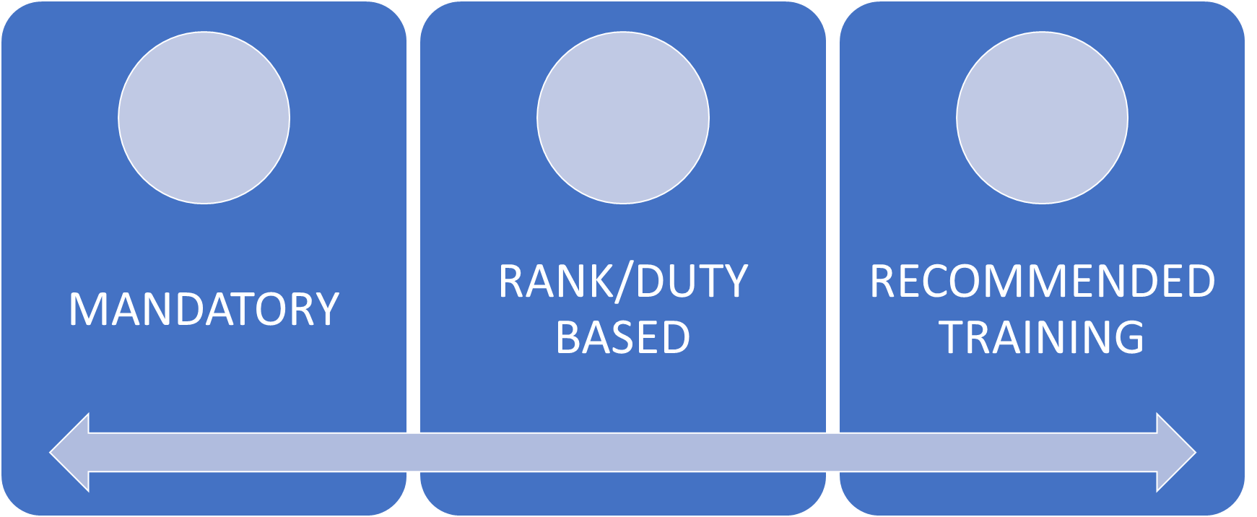
CATEGORIES OF PD TRAINING/
PROGRAMS
The PD points obtained from these three categories by calculation should sum up to the total required training points per the rank of the teacher.

Slide 14
Rank/Duty Based Training
Teachers at each rank are required to accrue certain number of PD points within a PD Cycle of 3-years. According to the PD computation tables in the CPD Framework, a teacher within 3 years will have to undertake all rank-based training programs assigned to his/her rank.
Each rank-based training gives 2 CPD points

Slide 15
Mandatory Training
According to the PD computation tables in the CPD Framework, a teacher within 3 years will have to undertake fifteen mandatory training programs.
Similar to the rank-based training, each mandatory training gives 2 CPD points

Slide 16
Recommended Training
In addition, teachers will have to access a number of recommended training programs to add up to the points accrued for rank based and mandatory.
These trainings may be recommended by the employer, NTC, GES, etc..

Slide 17
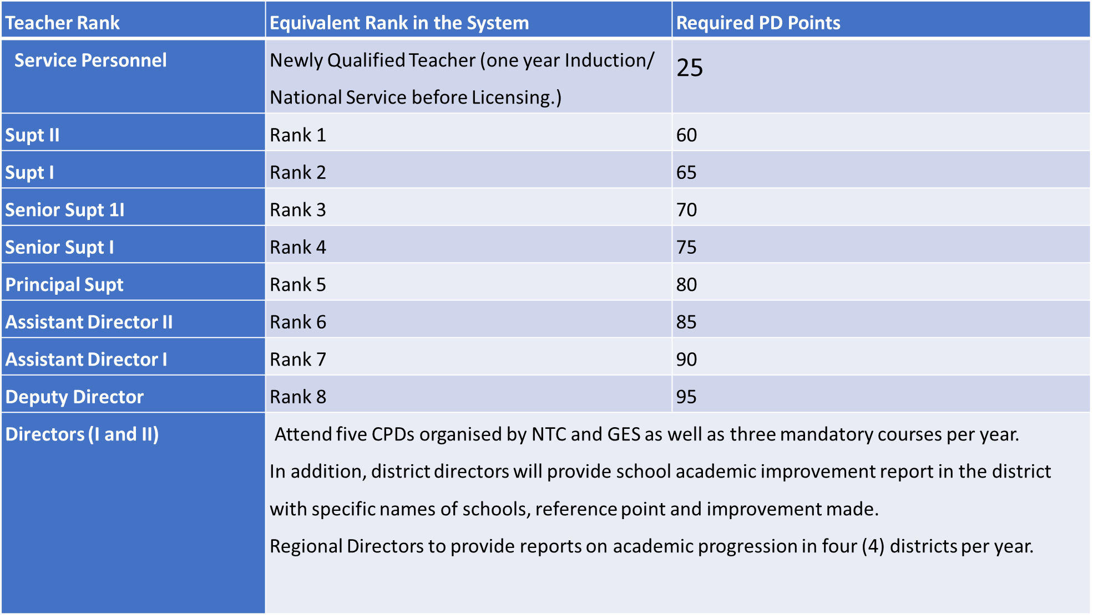
Suggested Minimum PD Points Required by Teachers on the Designated Ranks within the three (3) year Cycle

Slide 18
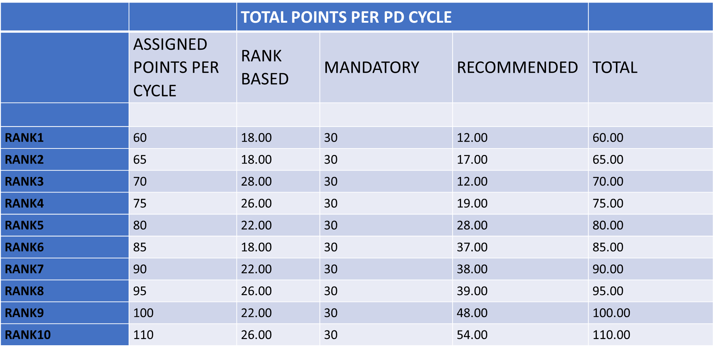
CALCULATION OF PD CREDIT POINTS

Slide 19
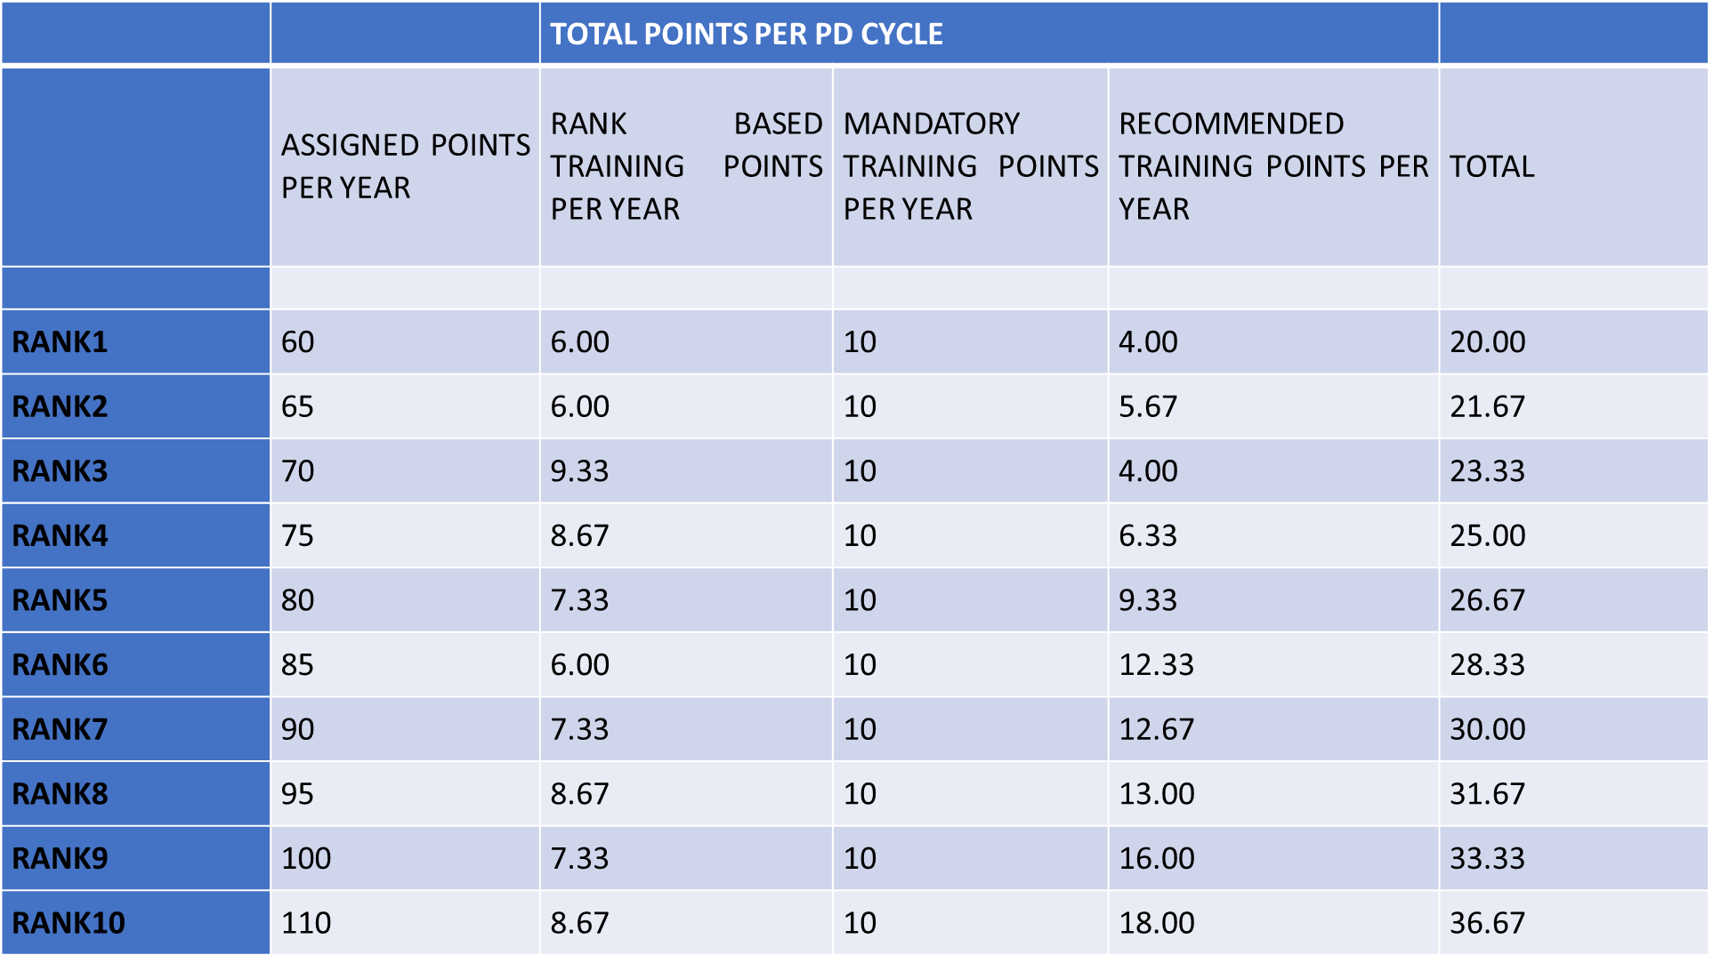
CALCULATION OF PD CREDIT POINTS (for each year)
YEAR (Minimum)
3-YEAR CYCLE
PER YEAR

Slide 20
CALCULATION OF REQUIRED PD CREDIT POINTS (MINIMUM) cont’d
Teachers are required to access a minimum of five (5) mandatory trainings in a year and a total of fifteen (15) in the three-year cycle. Therefore, to be able to determine the weight of a mandatory course for a specific rank, teachers will have to divide the number of points acquired from mandatory activities in the three (3) years by fifteen (15).
For instance, a teacher in Rank 1 is expected to obtain 30 points from mandatory trainings in three (3) years. Thus, fifteen (15) mandatory activities within three (3) years should attract 30 points. This means each mandatory program attracts a maximum of 2 points (30/15).

Slide 21
CALCULATION OF REQUIRED PD CREDIT POINTS (MINIMUM) cont’d
Moreover, a teacher in Rank 1 who needs 6 points from Rank-based training a in a year can determine the number of required rank-based activities to be accessed in a year to accrue the 6 points by dividing the 6 points by 2 (weighted points for one rank-based activity) and this gives three Rank-based trainings in a year.
Thus, two points are assigned to either rank-based or mandatory activity accessed by the teacher.
Similarly, for a teacher in Rank 2, the total Rank-based points to be accrued in three (3) years out of the nine (9) Rank-based activities is 18 (2 points by 9 activities). In addition, that teacher is expected to accrue 30 points from mandatory activities.

Slide 22
CALCULATION OF REQUIRED PD CREDIT POINTS (MINIMUM) cont’d
Therefore, the remaining activities will be accessed from the recommended activities based on computation in the points requirement table for each rank. Which means, the required points for recommended activity (rmp) for a teacher in any rank is calculated by making rmp the subject of the point based formula:
Py = Rp + mp + rmp
where mp = Mandatory training points for respective ranks
Rp = Rank/duty-based training points for respective ranks
rmp = Recommended activities points

Slide 23
CALCULATION OF REQUIRED PD CREDIT POINTS (MINIMUM) cont’d
Therefore, for rank 1 which requires 60 points in 3 years, the recommended training points can be calculated as
rmp + 30 + 18 = 60
rmp = 60 – (30 + 18)
rmp = 60 – (48)
rmp = 12
Teachers are to bear in mind that they are required to meet at least one-third of their training points in a year to maintain their professional standing status for a particular year.

Slide 24
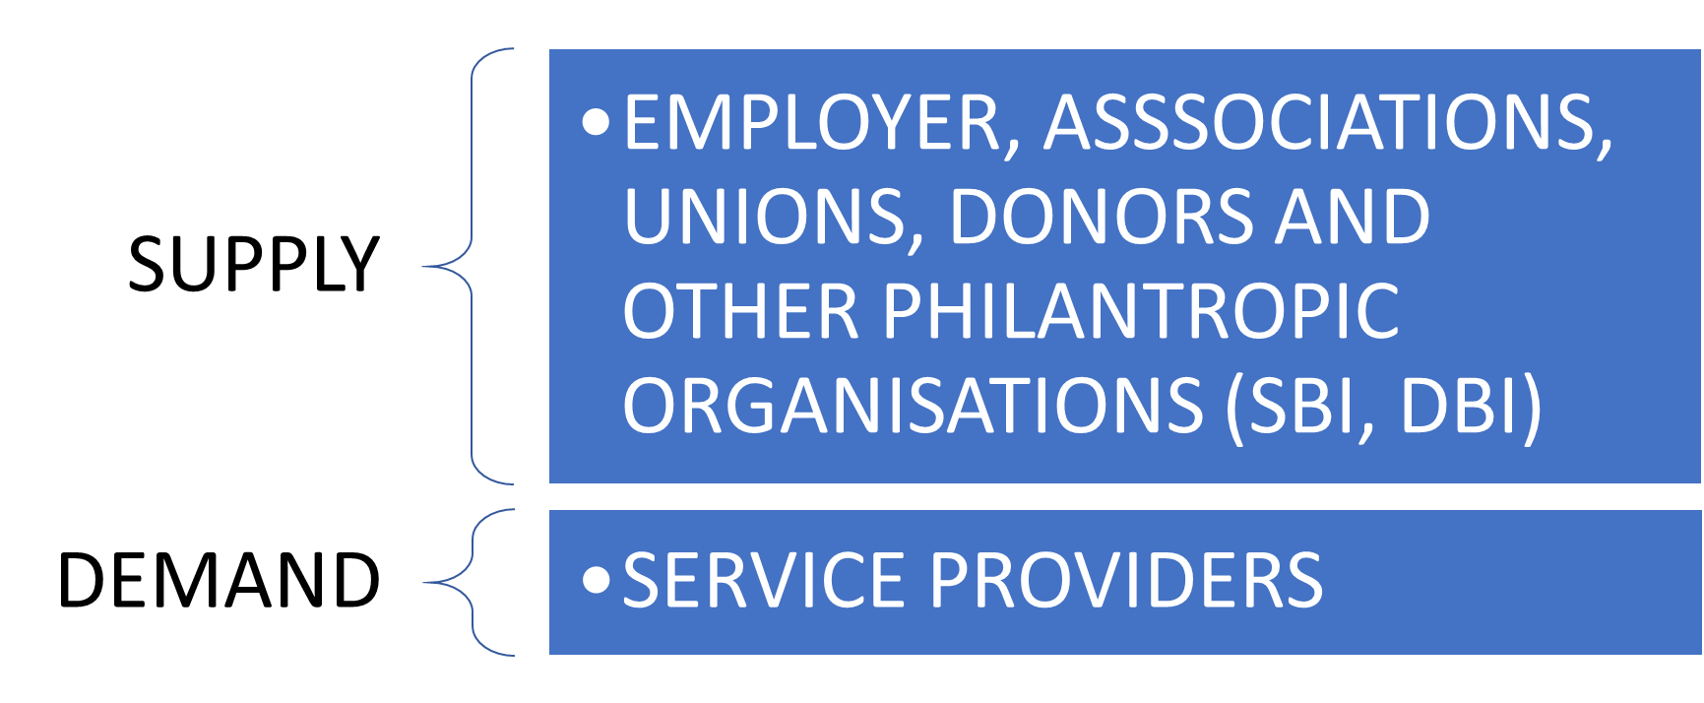
NATURE OF DELIVERY
In-service teachers will meet their training/program requirements
from both demand-driven and supply-driven sources

Slide 25
RELEVANCE OF POINT BASED SYSTEM
Renewal of License
The license of every teacher shall be renewed every three (3) years. To retain the license, an individual teacher must earn the stipulated minimum credit points of the current rank within three (3) years prior to license renewal date. However, teachers are required to meet one-third of their training points in a year to determine their professional standing status for a particular year.
Criteria for Selection
Teachers are advised to continue to participate in PD programs after earning the minimum credit points. This will help them to be abreast of current trends in education and also have comparative advantage over colleagues should it come to selection for Ghana Teacher Prize award and any other selection processes where PD points can be used as a determiner.
teachers who fail to obtain the minimum PD points on the third year of the current rank shall not be recommended to renew the teacher license and would therefore not be recognized as a teacher of good professional standing.

Slide 26

APPEALS
Any teacher whose license is not renewed for failure to achieve the minimum number of PD points and feels unfairly treated may appeal the decision in accordance with the provisions of the NTC regulations.

Slide 27
HOW TO SUBMIT PD INFORMATION
1. Participating teachers shall endeavor to crosscheck their PD records/training logbooks/portfolio records with NTC as means of validation of the data submitted by organizers of PD to NTC.
2. PD Service Providers shall log the training type (training code) in the Teachers ‘Training Logbook and subsequently use the on-line portal system to complete digital log after each PD program organized.
3. Entries of PDs such as SBI, CBI or any other forms organized within GES structures (Regional, District, Cluster, School or Department) shall be made by the organizing authority (Regional Director’s Rep, District Director’s Rep, CS and Head of institutions). In private schools, training points relating to SBI,CBI and DBI shall be verified by NTC through the assigned compliance officers.

Slide 28
UNIQUE CASES
Licensed Teachers who are not practicing teaching shall be required to submit evidence of workshops, trainings and seminars attended which relate to the teaching profession. If such is not provided for renewal, the teacher concerned may be requested to attend PDs related to the current rank before readmission into the profession.
Also, in situations where employers are not able to provide required number of supply driven activities for teachers, they (teachers) are required to rely on other available means to accrue the needed points.
Teachers who accept postings to ‘deprived areas’ shall be given training worth of 10 points by the employer (district) without payment of any training fee by the teacher.

Slide 29
ROLE OF EMPLOYERS OF TEACHERS
i. Granting teachers leave to attend PD programs.
ii. Liaising with NTC to bring to the notice of teachers relevant information pertaining to PD from time to time.
iii. Rewarding teachers who excel in PDs.
iv. Making participation in PD one of the criteria for enjoying certain benefits at work.
v. Making participation in PD a mandatory condition for promotion.
vi. Organize mandatory trainings for teachers including SBIs, CBIs and DBIs.
vii. Liaising with NTC to occasionally provide supply driven trainings to teachers.

Slide 30

Before we proceed to the next lesson,
let’s take the short quiz that follows.

